Slide 1
SYSTEMS

Slide 2
A system is a mathematical model of a physical process that relates the input signal to the output signal.
CT and DT SYSTEMS
If the input and the output signals x and y are continuous time (CT) signals, then the system is called a CT system. If the input and output signals are DT signals or sequences, then the system is called a DT system.

Slide 3
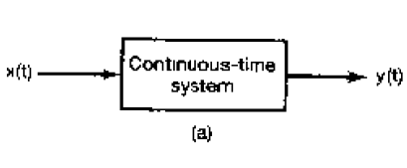
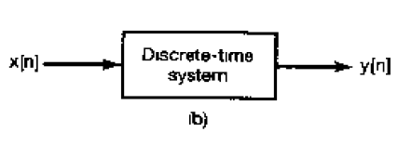

Slide 4
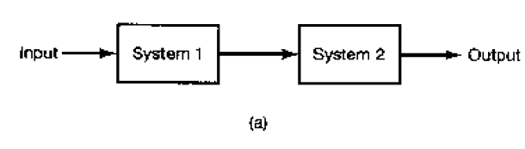
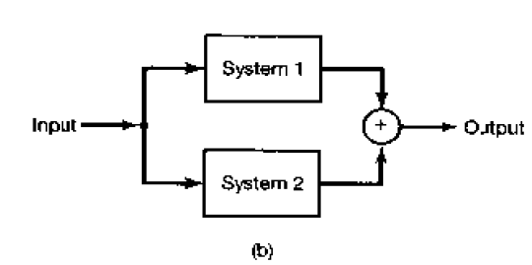
Interconnection of Systems

Slide 5
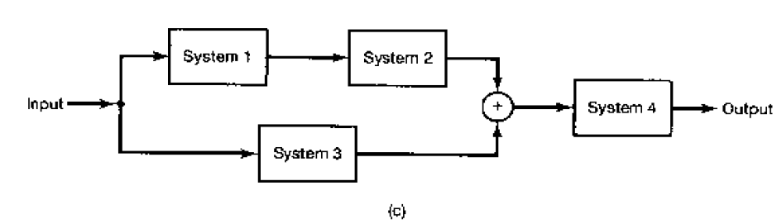

Slide 6
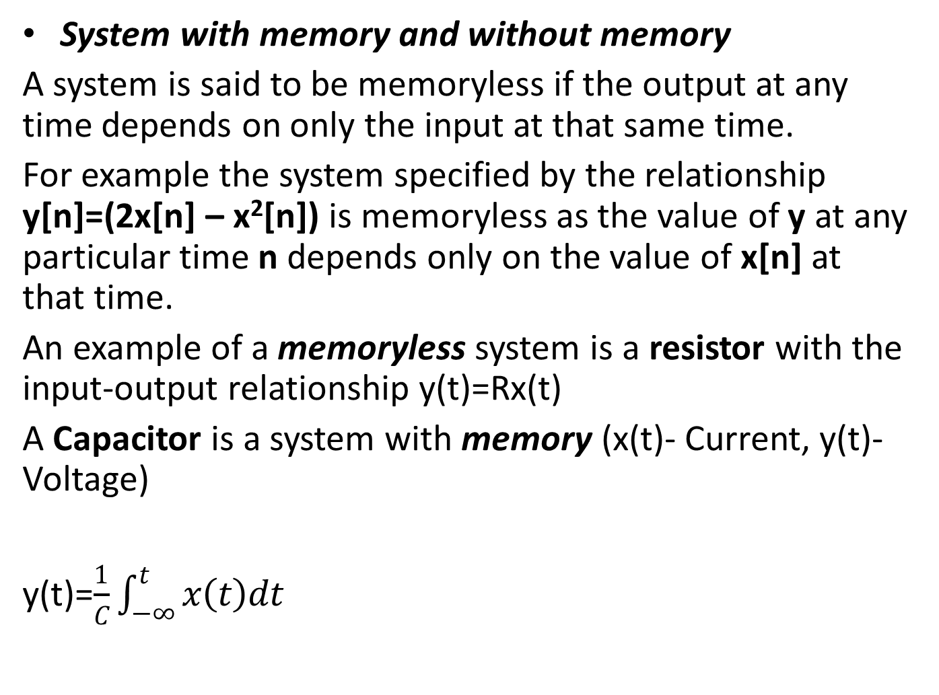
SYSTEM PROPERTIES
System with memory and without memory
A system is said to be memoryless if the output at any time depends on only the input at that same time.
For example the system specified by the relationship y[n]=(2x[n] – x²[n]) is memoryless as the value of y at any particular time n depends only on the value of x[n] at that time.
An example of a memoryless system is a resistor with the input-output relationship y(t)=Rx(t)
A Capacitor is a system with memory (x(t)- Current, y(t)- Voltage)
y(t)=$\frac{1}{C}\int_{−∞}^{t}{x\left(t\right)dt}$

Slide 7
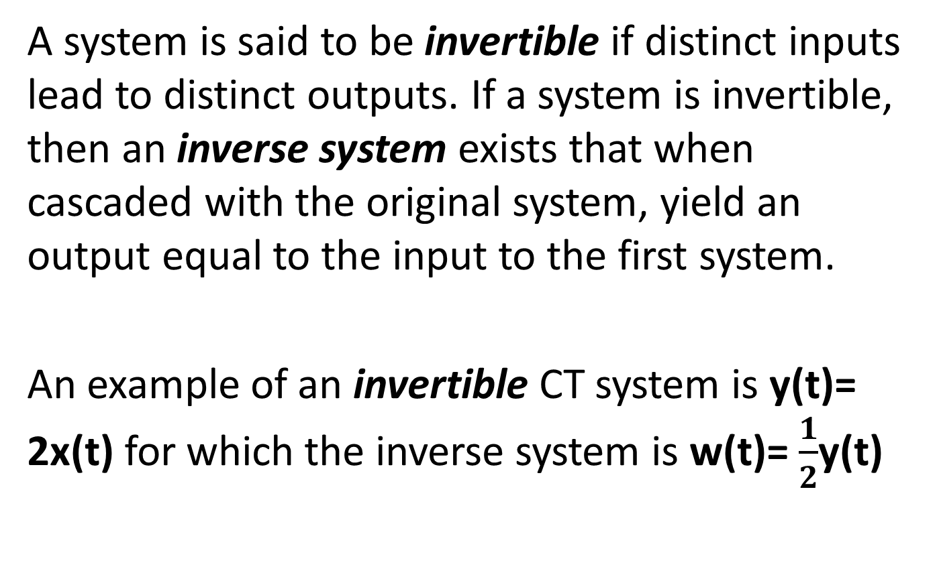
Invertibility and Inverse Systems
A system is said to be invertible if distinct inputs lead to distinct outputs. If a system is invertible, then an inverse system exists that when cascaded with the original system, yield an output equal to the input to the first system.
An example of an invertible CT system is y(t)= 2x(t) for which the inverse system is w(t)= $\frac{1}{2}$y(t)

Slide 8
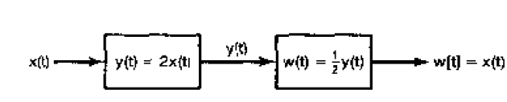

Slide 9
Causal and Noncausal Systems
A system is causal if the output at any time depends only on values of the input at the present time and in the past. A system which is not causal is Noncausal. Examples of Noncausal systems are;
y(t)= x(t+ 1)
y[n]= x[-n]

Slide 10
Stable Systems (Stability)
A system is bounded-input / bounded-output (BiBo) stable if for any bounded input x defined by |x|≤ k₁ the corresponding output y is also bounded and defined by |y|≤ k₂ where k₁ and k₂ are finite real constants.

Slide 11
Time Invariance
A system is called time-invariant if a shift (delay or advance) in the input signal causes the same time shift in the output signal. That is, if x(t) produces y(t), then x(t - t_{o}) must produce y(t- t_{o}) for any value of t_{o}.
To check a system for time-invariance, we can compare shifted output with the output produced by the shifted input.

Slide 12
Example
Consider the CT system defined by y(t)= sin[x(t)]
If x₁(t) is an arbitrary input, then
y₁(t)= sin[x₁(t)]----------------------------(1)
If x₂(t)= x₁(t- t_{o})
→y₂(t)= sin[x₂(t)] = sin[x₁(t- t_{o})]--------------(2)
Similarly from equation (1)
y₁(t- t_{o})= sin[x₁(t- t_{o})]-------------------------------(3)
Comparing eqns (2) and (3) we see that
y₂(t)=y₁(t- t_{o}) and therefore,
The system is time-invariant

Slide 13
Linear Systems (Linearity)
A linear system, in CT or DT,is a system that possesses important property of superposition; if an input consists of the weighted sum of several signals, then the output is the superposition that is, the weighted sum-of the responses of the system to each of these signals.
Let y₁(t) be the response of a CT system to an input x₁(t), and let y₂(t) be the output corresponding to the input x₂(t) then the system is linear if;
1. The response to x₁(t) + x₂(t) is y₁(t) + y₂(t).
2. The response to ax₁(t) is ay₁(t), where a is any complex constant.
Property 1 is known as the additivity property and property 2 is known as the scaling or homogeneity property.

Slide 14
Example
Consider a system S whose input x(t) and output y(t) are related by
y(t)= tx(t)
To determine whether or not S is linear, we consider two arbitrary inputs x₁(t) and x₂(t)
X₁(t) → y₁(t) = tx₁(t)
X₂(t) → y₂(t) = tx₂(t)
Let x₃(t) be a linear combination of x₁(t) and x₂(t), that is
x₃(t)= ax₁(t) + bx₂(t) , where a and b are arbitrary scalars.
If x₃(t) is the input to S, then the corresponding output may expressed as
y₃(t)= tx₃(t)
= t(ax₁(t) + bx₂(t))
= atx₁(t) + btx₂(t)
= ay₁(t) + by₂(t)
We conclude that S is linear

Slide 15
How is a System Represented?
A system takes a signal as an input and transforms it into another signal
In a very broad sense, a system can be represented as the ratio of the output signal over the input signal
That way, when we “multiply” the system by the input signal, we get the output signal
This concept will be firmed up in the coming weeks
Input signal
x(t)
System
Output signal
y(t)

